Slide 1




VOIS Innovation
Marathon 2.0

Slide 2





Aegis AI- Disaster Management & Resource Optimization
49
Team No.
Arham Kelkar- AI&DS
Insert your professional photo
Dr. DY Patil School of Science & Technology
Pune , Maharashtra
Nitin Chauhan- AI&DS
Omkar Kale - CSD

Slide 3
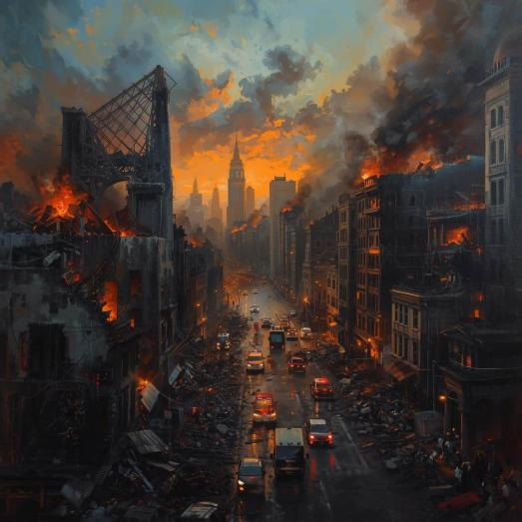
Problem Statement
Global disaster response suffers from a reactive paradigm that collapses during "Black Sky" events crises where communication blackouts force rescue teams to rely on outdated data and dangerous guesswork.
This "intelligence lag" amid rising climate and seismic threats results in thousands of preventable deaths and an economic drain projected to reach $145 billion in losses by 2025.

Slide 4

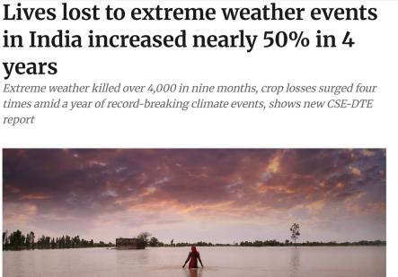
Need of Project
Surging Mortality: India saw a 48% increase in deaths from extreme weather over four years, with 4,000+ fatalities in early 2025 alone.
Source: DownToEarth

Slide 5

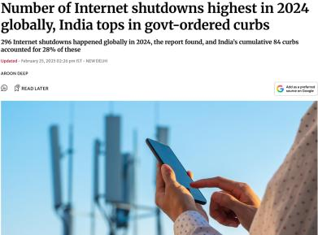
Need of Project
Infrastructure Fragility: With 84 internet shutdowns in 2024, India leads globally, making "offline-first" resilience vital when central backbones fail during regional crises.
Source: thehindu.com

Slide 6

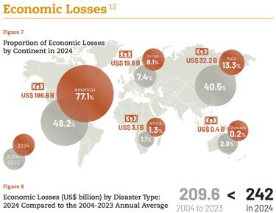
Need of Project
Economic Devastation: Global disaster damages hit $242 billion in 2024, with sector losses rising 49% due to inefficient response and supply chain mismanagement.
Source: 2024 EMDAT Report

Slide 7

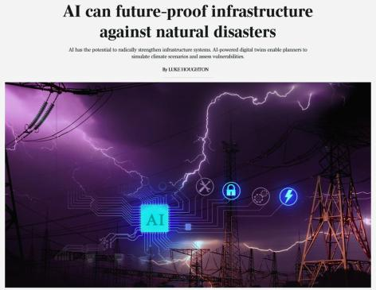
Need of Project
Life-Saving Potential: AI-driven predictive logistics and resource optimization can solve these systemic failures, potentially reducing preventable disaster deaths by 40%.
Source: The Australian

Slide 8




Proposed Solution
Aegis Swarm AI
A network of specialized agents (Sentinel, Oracle, Logistics).
AI Value
Human-like reasoning via Gemini for complex crisis planning.
NGO Perspective
A low-cost, scalable platform that prioritizes social impact over profit.
Verified Ground Truth
Aegis AI integrates real-time human validation to ensure AI assessments are grounded in physical reality for accurate dispatching.

Slide 9
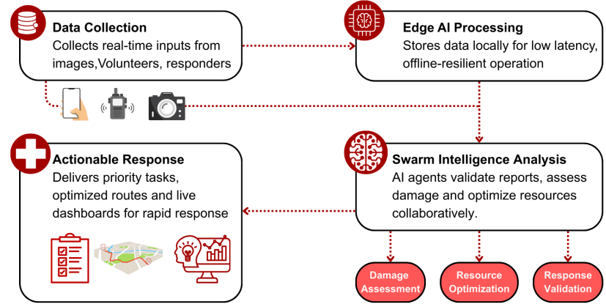
Solution Overview
Damage
Assessment
Resource
Optimization
Response
Validation

Slide 10
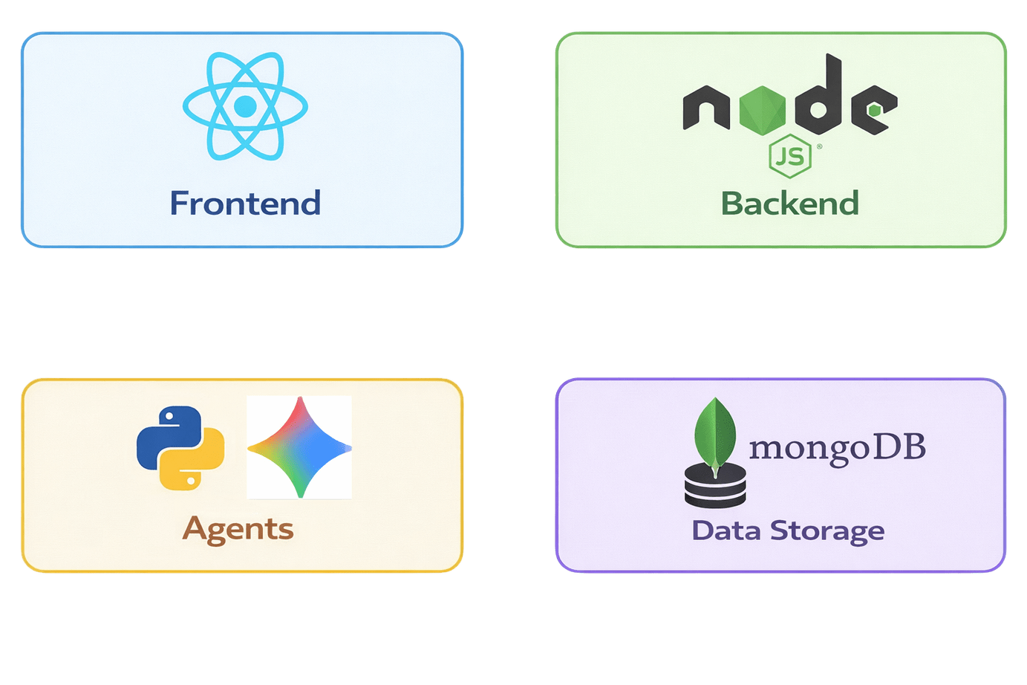
Technology Used

Slide 11
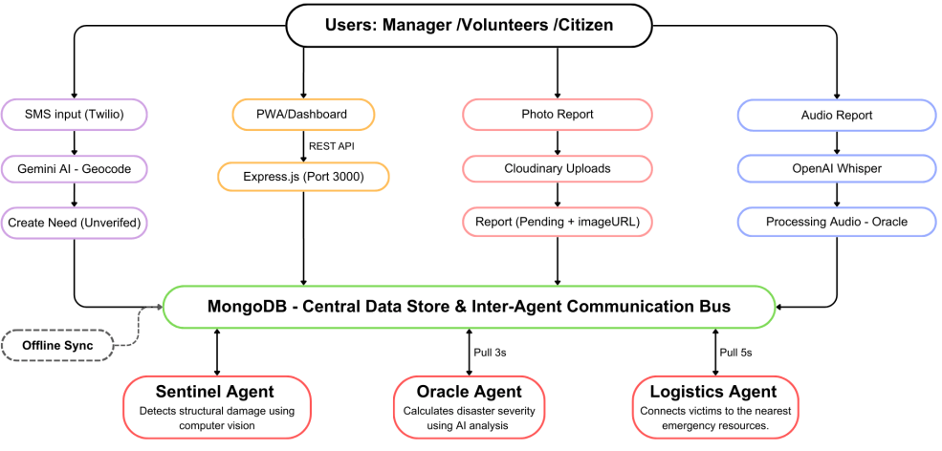
Technical flow diagram -

Slide 12








Architecture Blueprint
User Interfaces (Field Responders / Coordinators)
01
The system provides a React Dashboard, a Volunteer PWA App, and an Emergency Station UI.
Node.js API Layer
02
The layer consists of an API Gateway, Authentication, Request Routing, and Alert Services.
Intelligence Layer
03
It consists of the Sentinel Agent for vision, the Oracle Agent for decision-making, and the Logistics Agent for planning.
Data & Infrastructure Layer
04
The layer consists of IndexedDB for offline-first storage, the NGO Resource Database, and Resilience Protocols.

Slide 13
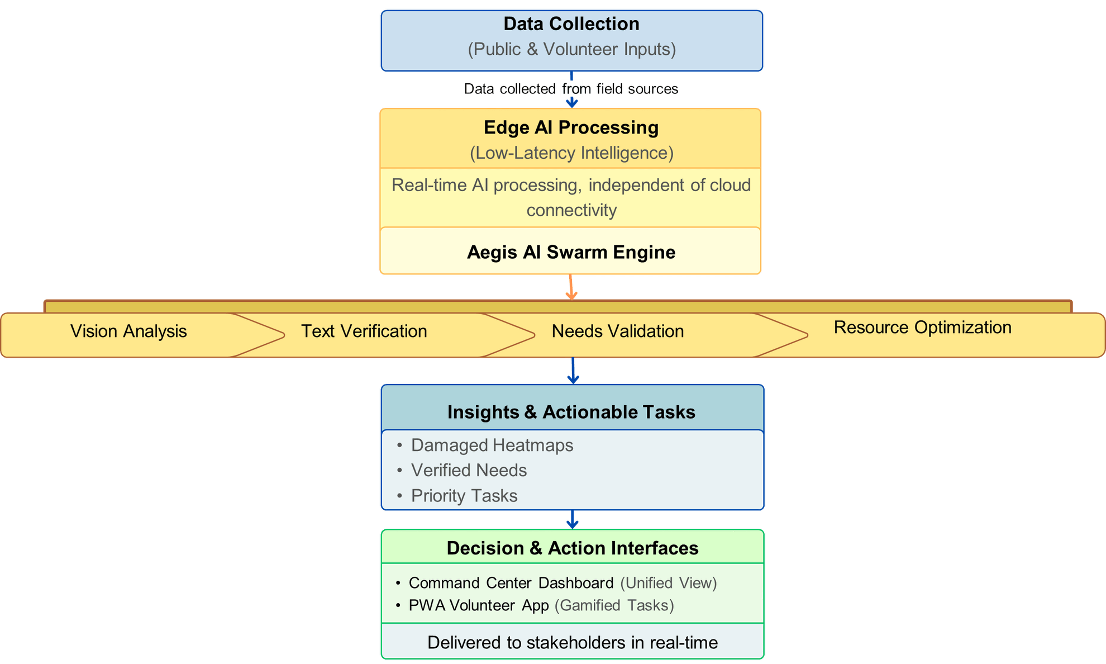
Workflow Diagram

Slide 14
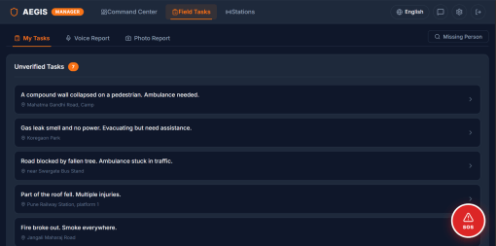
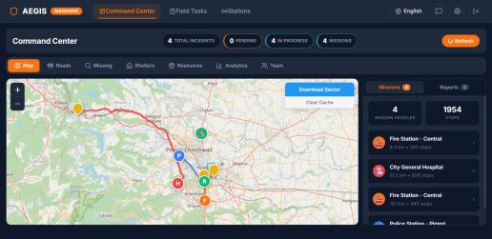
Screen shots of your project -

Slide 15
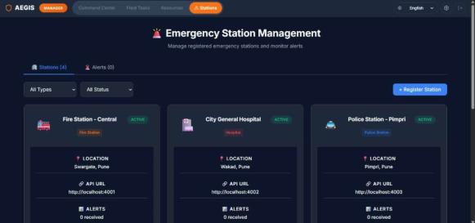
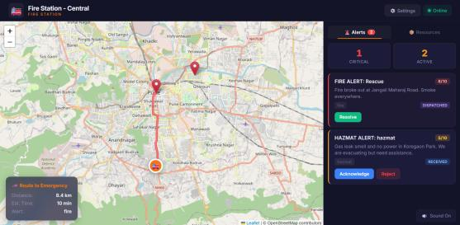
Screen shots of your project -

Slide 16
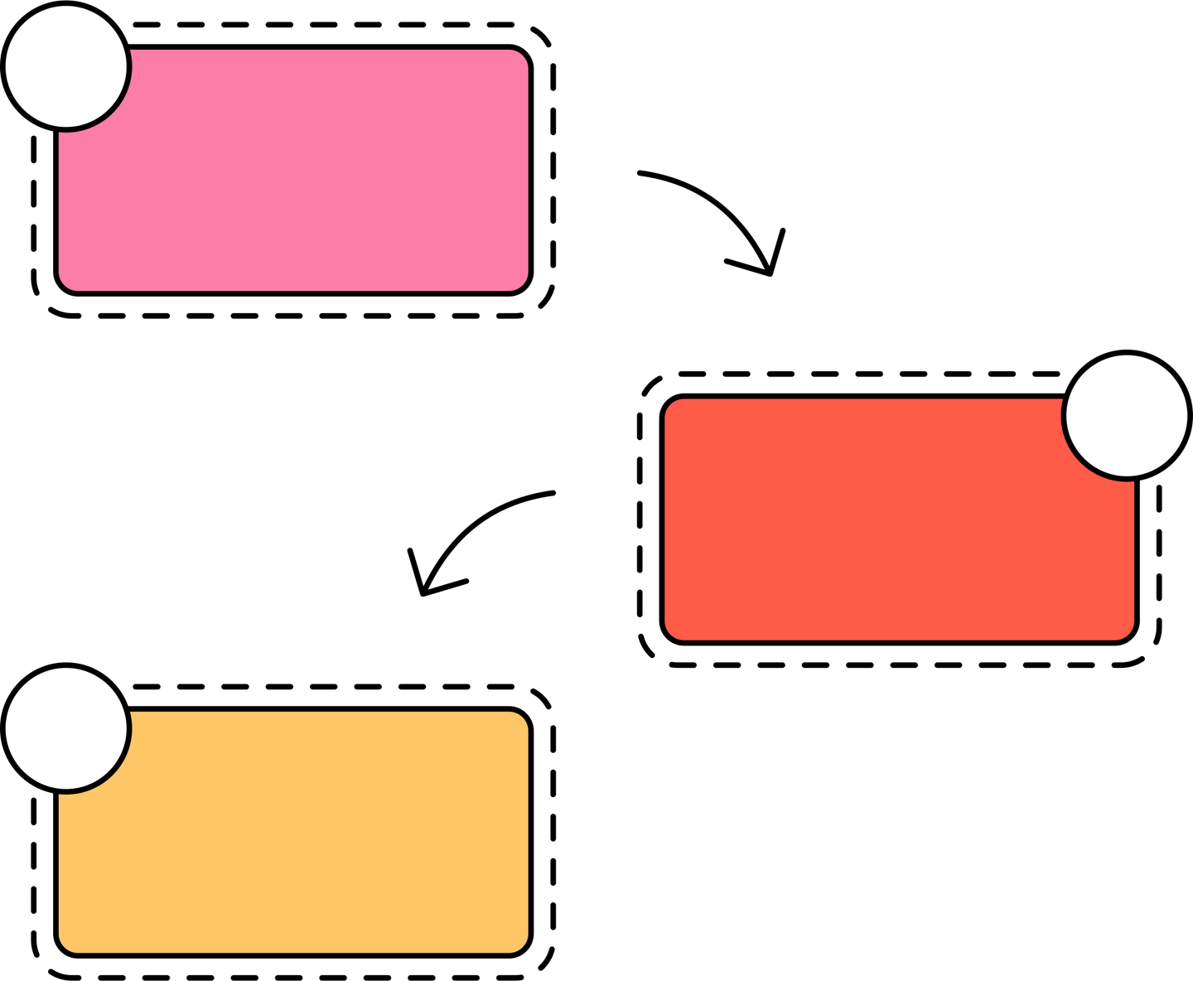


Role of Agentic AI and Gen AI in the Solution
1
Agent 1
Multi-Model Crisis Understanding
The Sentinel
Detects structural damage using computer vision
Interprets text, voice, and image data
2
Agent 2
Reliable, Bias-Free Validation
The Oracle
Calculates disaster severity using AI analysis
Reduces human dependency with reliable, bias-free validarion
3
Agent 3
The Logistics
Real-Time Decision Making
Connects victims to the nearest emergency resources.
Enable faster, real-time decision-making

Slide 17
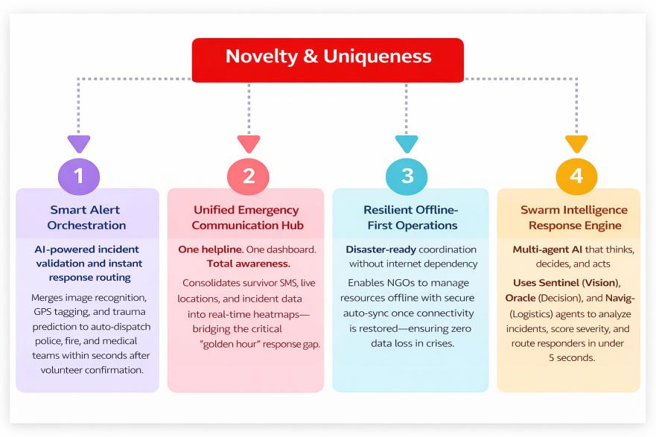

Slide 18
Github Link:
Github Link: https://github.com/KaleOmkar846/Disaster-Resource-Optimizer-AI

Slide 19



Future Scope
Predictive Disaster Modelling
Using historical data to predict disasters before they occur.
Autonomous Drone Fleets
Direct integration with drone swarms for automated search and rescue.
Global NGO Expansion
Scaling the platform for international disaster zones.

Slide 20
Thank You

